Slide 1
Production & Consumption of food around the world
A group effort by
Catherine, Charles, iryna (the group)

Slide 2
Scope of Research
The Food and Agriculture Organization of the United Nations provides free access to food and agriculture data for over 245 countries and territories, from the year 1961 to the most recent update. It presents a comprehensive picture of the pattern of a country’s food supply during a specified reference period, the last time an update was loaded to the FAO database was in 2013. The food balance sheet shows for each food item the sources of supply and its utilization. This chunk of the dataset is focused on two utilizations of each food item available:
Food - refers to the total amount of the food item available as human food during the reference period.
Feed - refers to the quantity of the food item available for feeding to the livestock and poultry during the reference period.
We were going to focus on the data analysis of sugar vs. eggs.
However…..
Data: Who eats the food we eat?

Slide 3
Questions to Answer
Are the top 5 countries that consumes the most products also in the top 5 producing countries?
What are the top 5 producing items and top 5 consumed items?
Are the top 5 produced products also the top 5 consumed?

Slide 4
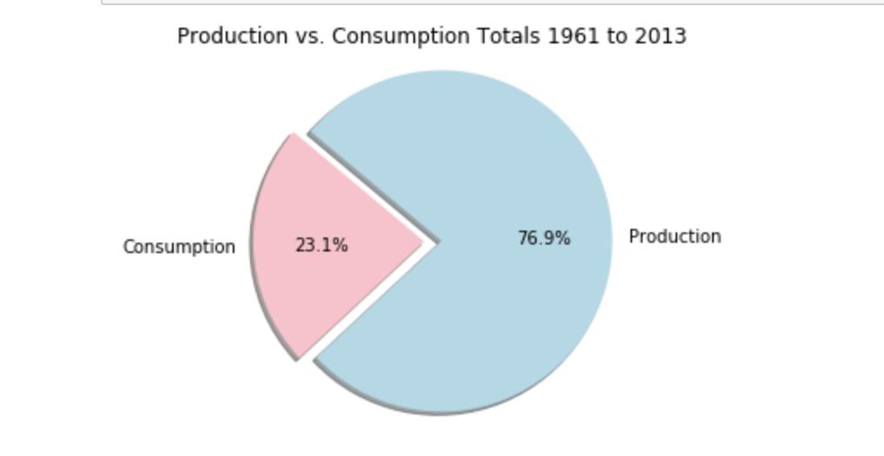
Cleaning the data. First findings

Slide 5
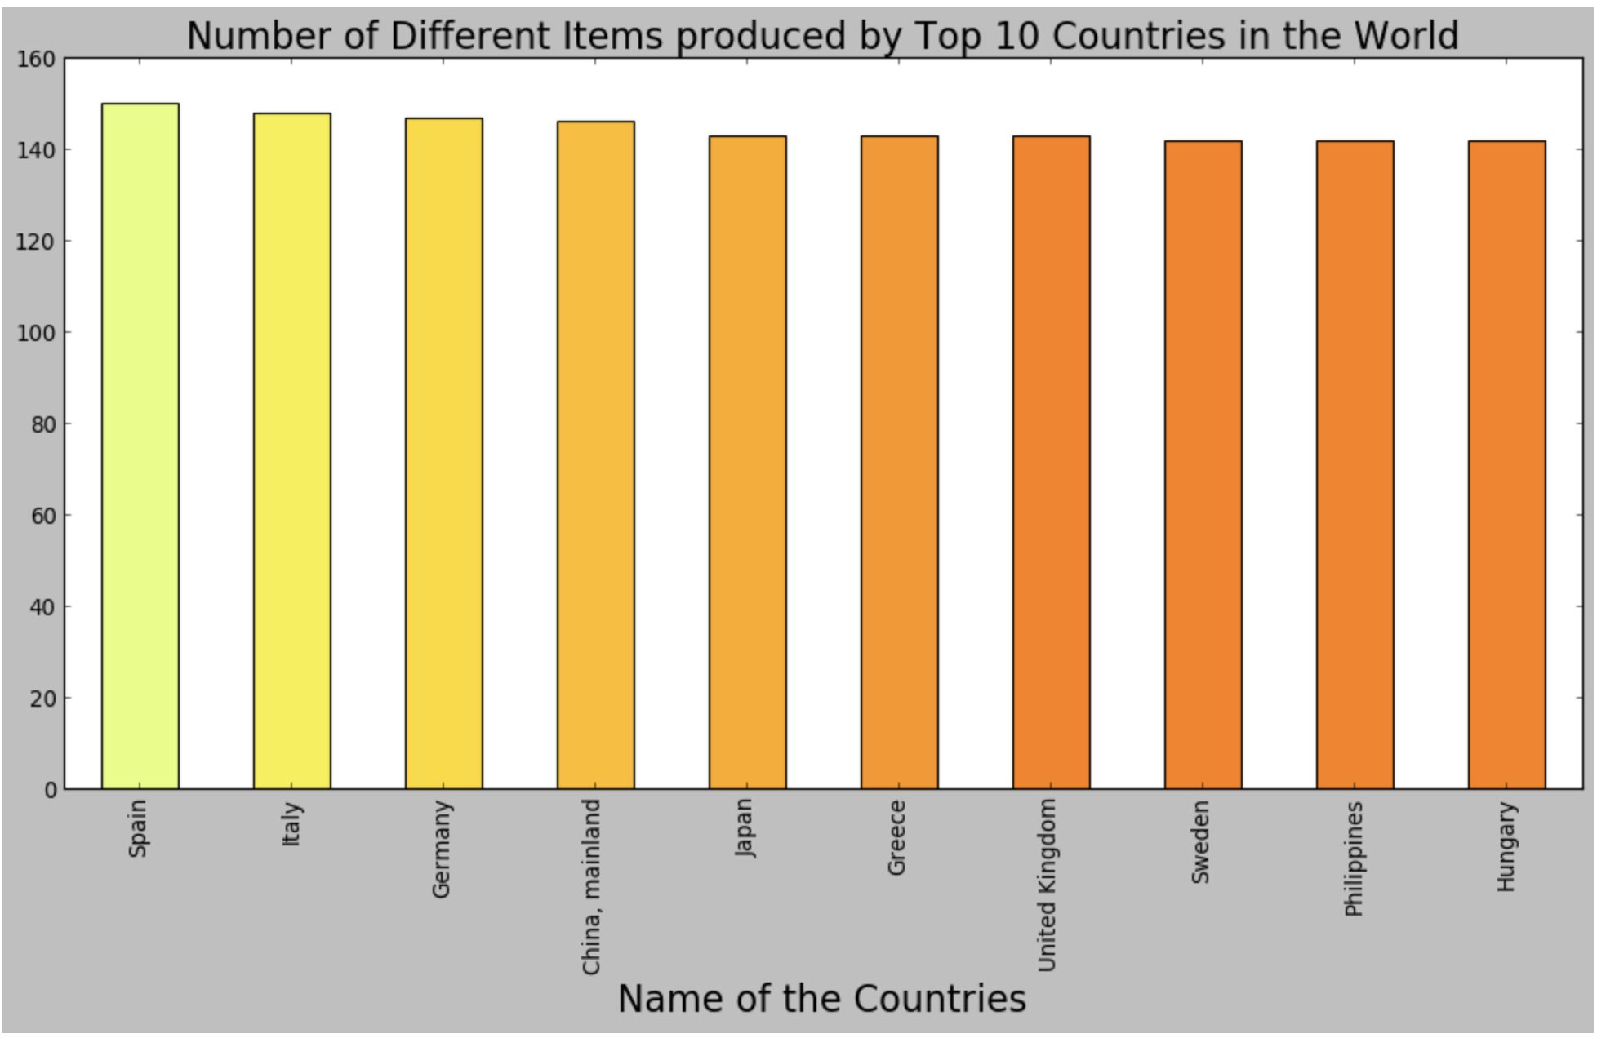
Since the overall picture did not tell us much…

Slide 6
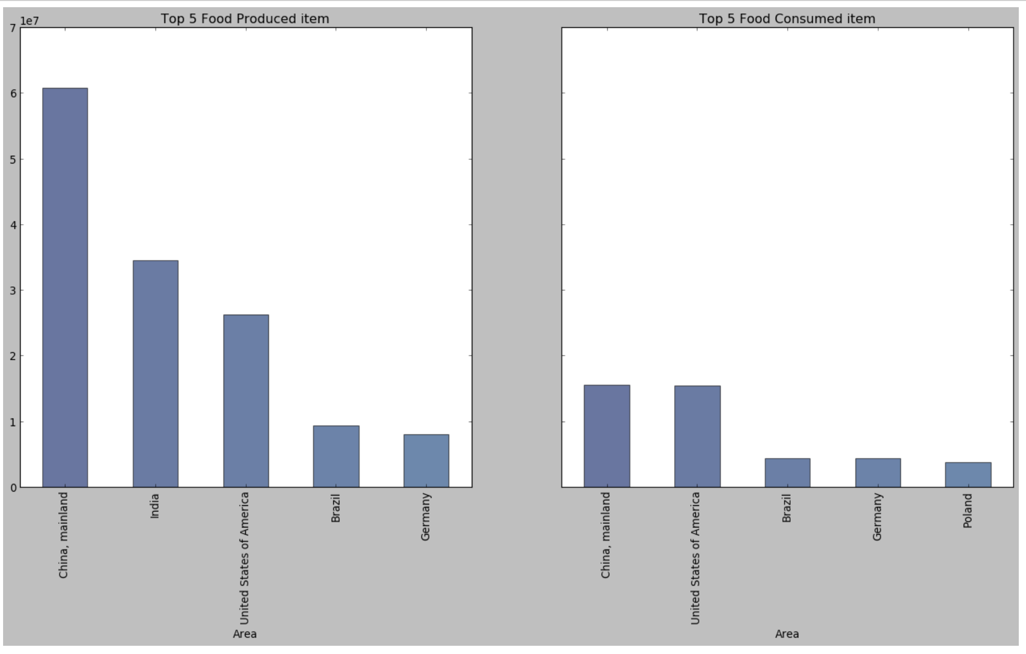
We went further in data

Slide 7
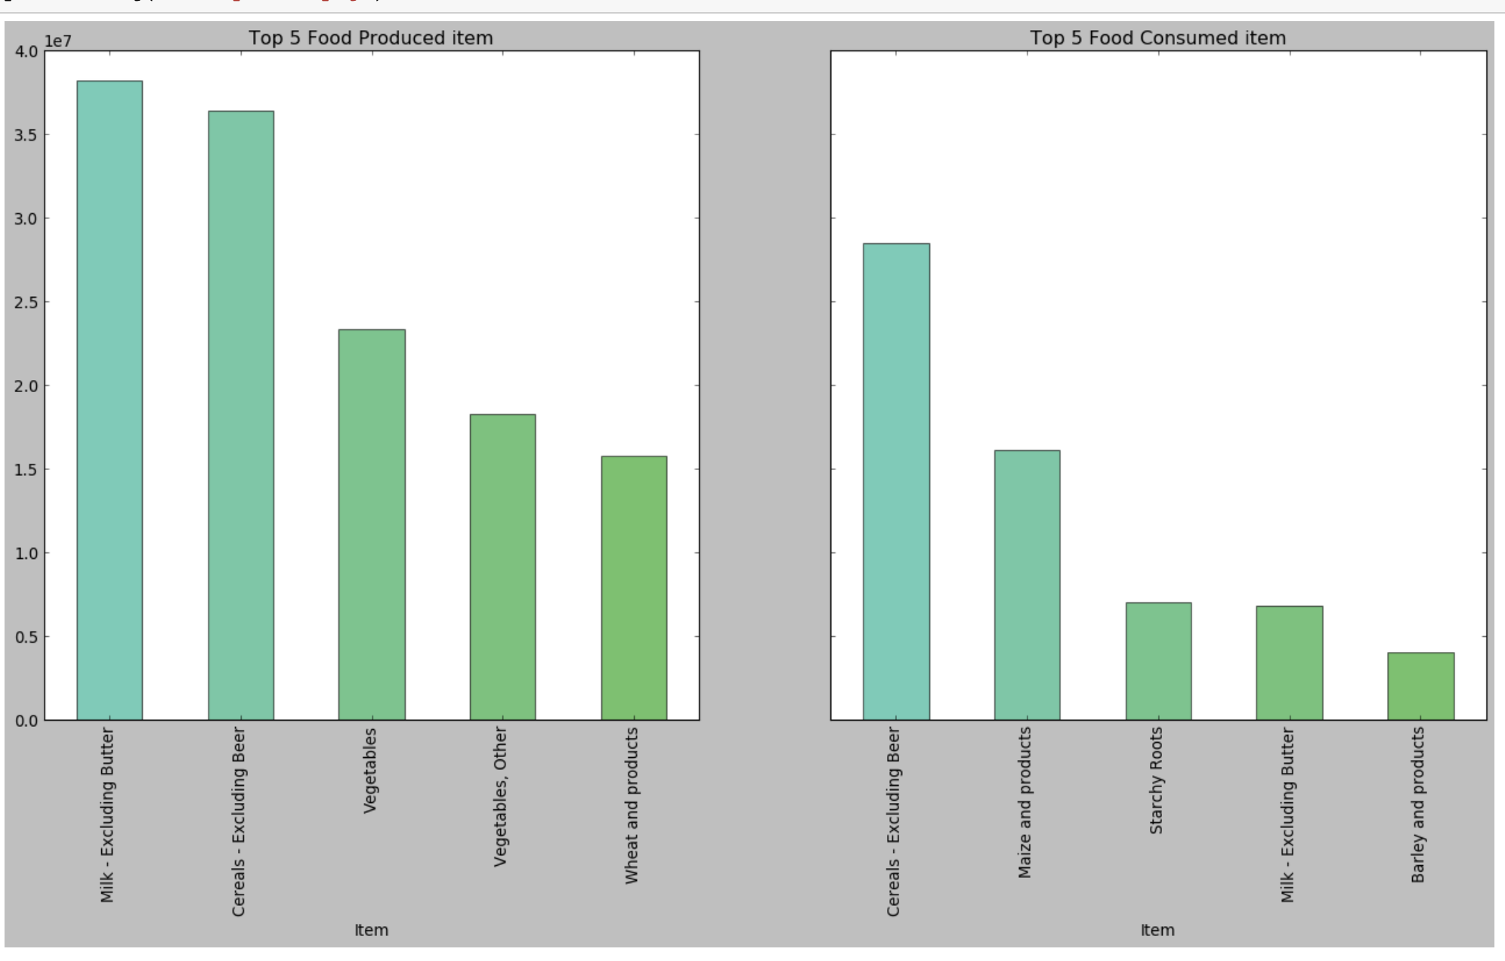
To drill down even more…

Slide 8
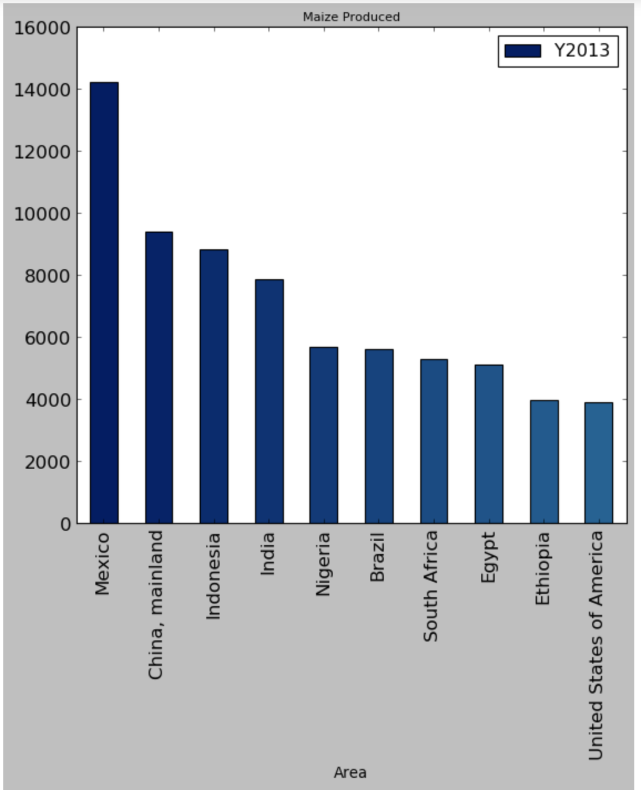
Finding the top producer of the top produced item

Slide 9
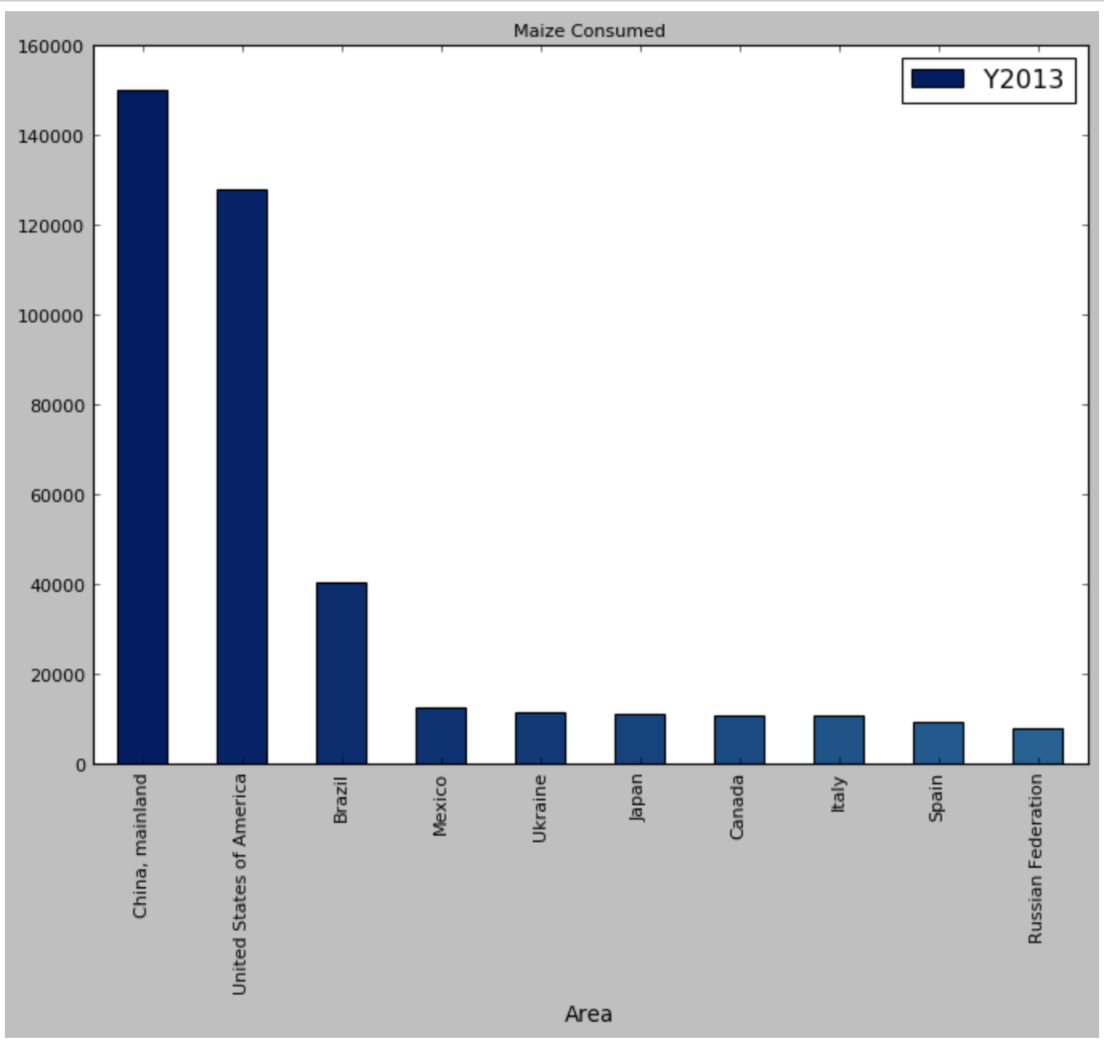
Finding the top consumer of the top produced item

Slide 10
Heatmap of produced food

Slide 11
Issues we ran into:
Too much focus on the data clean up;
Problem/question we are trying to solve/answer;
Trying to drill down to a specific item in the data, due to lack of experience/lack of code knowledge;

Slide 12
Questions we would work on if we had more time:
Add another dataset with the population information to try and predict the population growth vs the food production;
Compare the population growth vs food production over the past years;
Add hunger rates all over the World vs the food production and consumption.

